Slide 1

Home Price Prediction
Sashidhar Bezawada

Slide 2
Agenda
Introduction
Dataset & Source
Data Transformation
Exploratory Data Analysis
Risks / Contingencies
Models & Metrics
Result Interpretation
Conclusion
Ethical Considerations
References

Slide 3

Introduction
In recent years, the real estate industry has experienced rapid growth, making it an interesting area for research and experimentation. One common task in this field is forecasting house prices, which can be challenging due to the complex and dynamic nature of the market.
In this experiment, we will perform EDA and build models, to analyze data and make predictions about house prices. By applying this technique, we aim to gain insights into the factors that affect house prices and improve our ability to forecast them accurately.
Business Problem :
Develop a machine learning model to address the below:
Predict the sales price for each house.
Evaluate Root-Mean-Squared-Error (RMSE) between the logarithm of the predicted value and the logarithm of the observed sales price

Slide 4
Dataset & Source
The Ames Housing dataset was compiled by Dean De Cock for use in data science education. It's an incredible alternative for data scientists looking for a modernized and expanded version of the often-cited Boston Housing dataset.
File descriptions:
train.csv - the training dataset having 1460 records and 81 columns.
data_description.txt - full description of each column, originally prepared by Dean De Cock but lightly edited to match the column names used.
Column : SalePrice - the property's sale price in dollars. This is the target variable that we are trying to predict.
https://www.kaggle.com/competitions/house-prices-advanced-regression-techniques/data

Slide 5
Data Transformation
I have performed the duplicate checks, found none.
The category attributes were also converted to numerical types using one-hot encoding.
Most of the columns seem to be poorly correlated with one another. Generally, when making a predictive model, it would be preferable to train a model with features that are not too correlated with one another so that we do not need to deal with redundant features.
All the variables were explored for numeric and non-numeric separately. Nearly 20 Columns were dropped as they were not adding value or poor correlation.
For eight Variables, Labelling of Categories in Numerical Features were performed

Slide 6
Exploratory Data Analysis

Slide 7
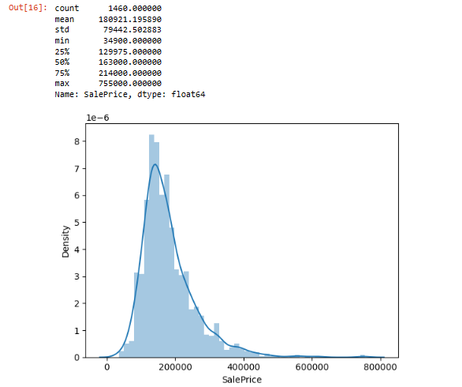
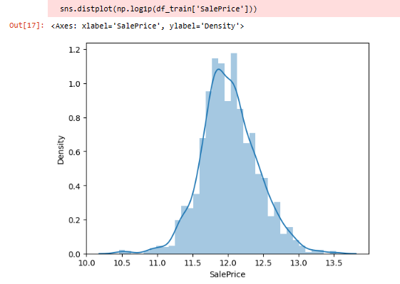
Data Visualizations
Target Class Distribution
Notes:
After the dataset was cleansed and transformed, different explorations were performed to gain a better understanding of the data especially in relation to the target variable (‘SalePrice’). In assessing the ‘SalePrice’ variable’s class distribution, it became apparent that the classes were highly imbalanced in their representation of the home sales .The Saleprice figures are skewed towards left. So, I have applied the log transformation to obtain a centralized data.

Slide 8
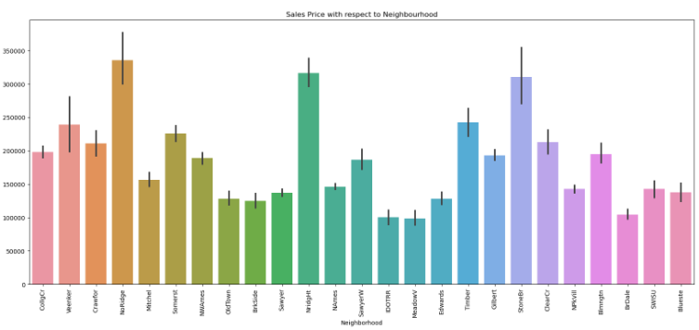
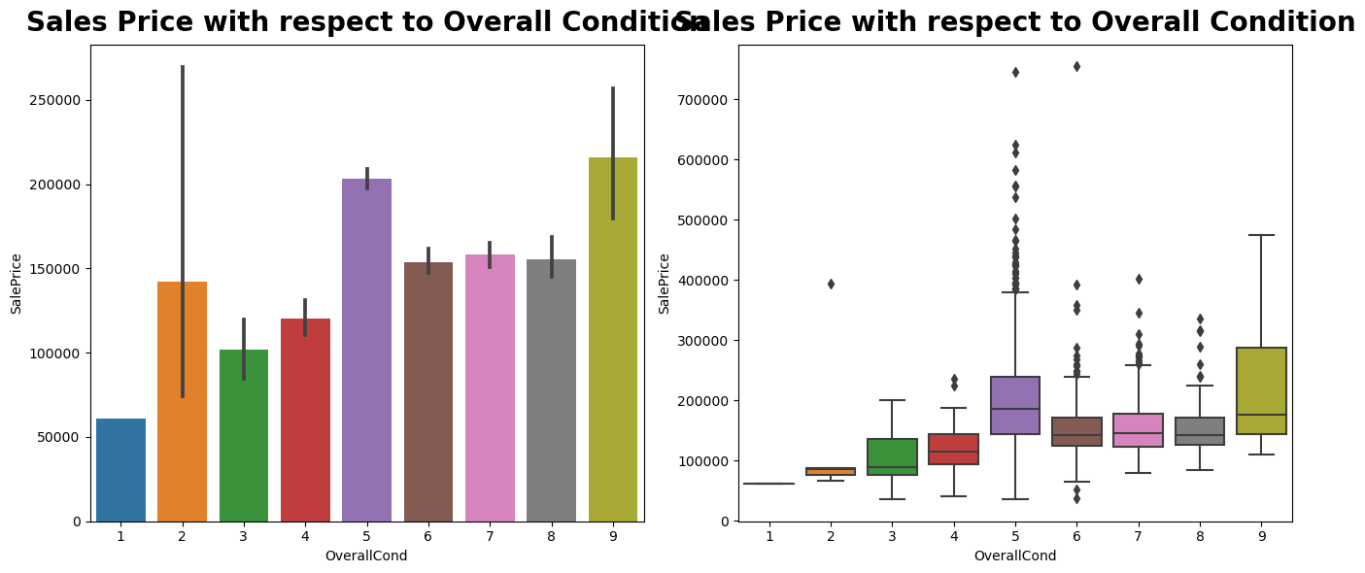
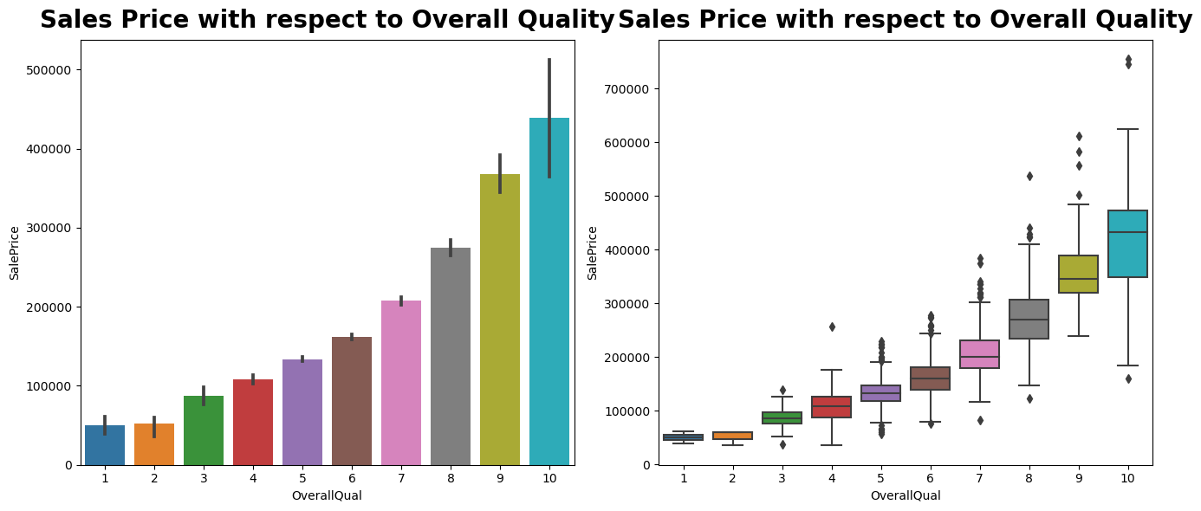
Data Visualizations
Feature Importance Visualizations
Notes:
Besides investigating how to predict the Saleprice of the homes, I also reviewed the factors which were important in the home sale price. Based on the bar plots, properties in some of the neighborhoods are high priced. Overall Condition & Overall Quality of the Homes also contributed in the Higher Sale Price of the homes.

Slide 9
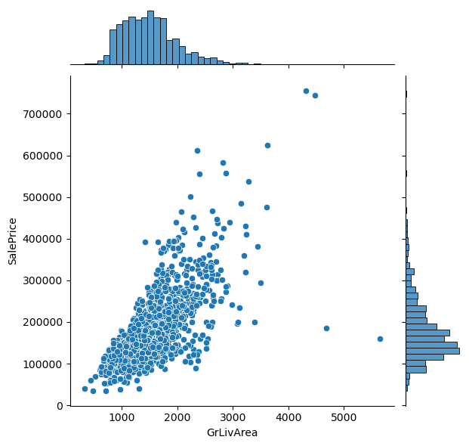
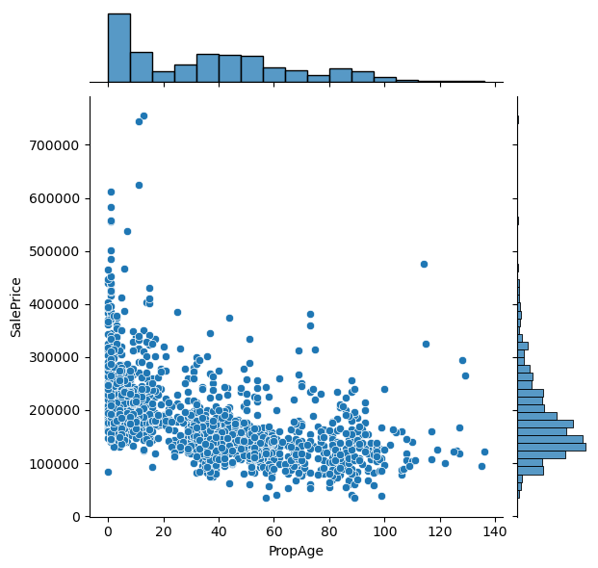
Data Visualizations
GrLivArea vs SalePrice
PropAge vs SalePrice
Notes:
Based on the Joint plot and the scatterplot, there is a positive relationship between the columns 'SalePrice' and ‘GrLivArea’ because if the values of one variable have increased, so does the other. And the other joint plot shows the negative relationship between the columns ‘SalePrice’ and ‘PropAge’ , increase in Property Age shows a decreasing saleprice trend i.e newer the property, high is the value.

Slide 10
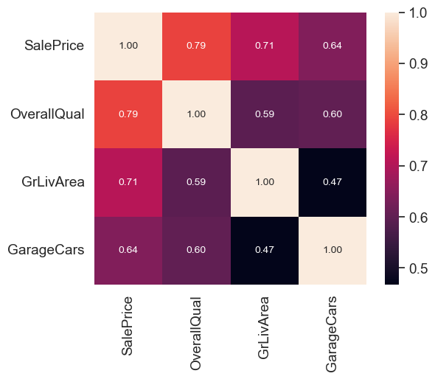
Data Visualizations
Heat maps to identify the correlation :
From the correlation plots, most of the columns seem to be poorly correlated with one another. Generally, when making a predictive model, it would be preferable to train a model with features that are not too correlated with one another so that we do not need to deal with redundant features.

Slide 11
Risks / Contingencies
The predictive modeling portion of this project posed a great challenge, in terms of yielding even relatively acceptable accuracies and RMSE. The target variable had 81 classes, and once the dataset was split into training and test sets, there was not enough representation per class to give the models proper training.
However, this dataset was limited in scope in that it contained actual data. I made the assumption that this would be enough information to create reasoning on the Home Sale Price, but it would have been beneficial to find other datasets that focused more on other livability features.

Slide 12
Models
&
Metrics

Slide 13
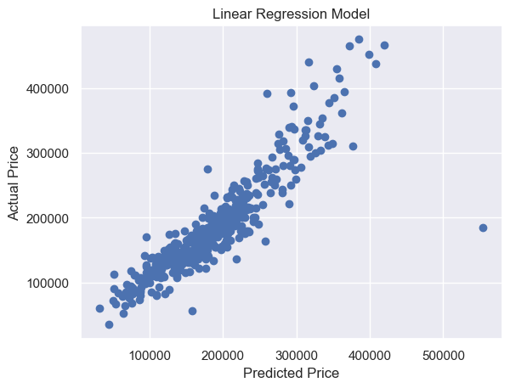
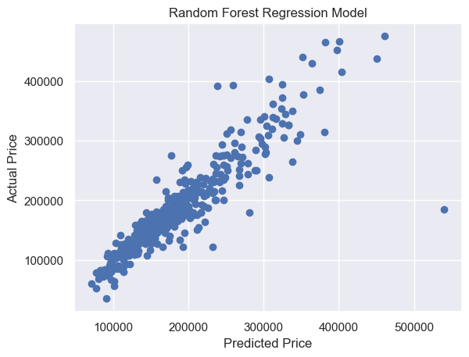
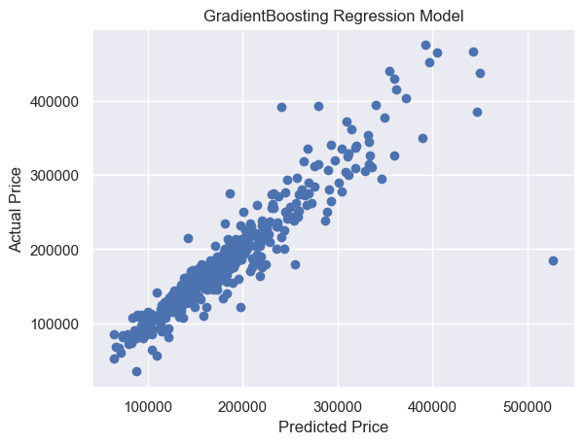
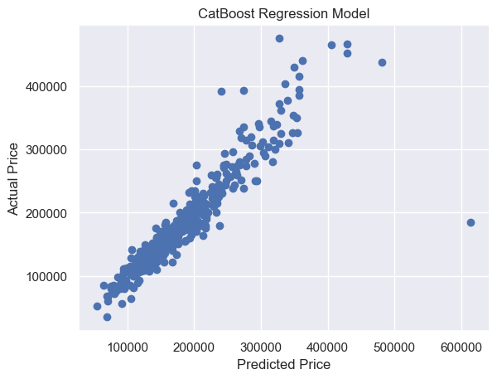
Price : Actual vs Prediction ( Scatter Plots )
Linear regression seeks to find the best-fitting straight line that describes the relationship between the input variables and the output variable. This line is determined by minimizing the difference between the predicted values from the model and the actual values observed in the data.
Random Forest is a machine learning algorithm that builds multiple decision trees during training, each trained on a random subset of the data and using a random subset of features at each split. It combines the predictions of these trees to produce a final prediction. Random Forest is known for its high accuracy, resistance to overfitting, and ability to handle noisy data effectively
Linear Regression
Random Forest
Gradient boosting works by building simpler (weak) prediction models sequentially where each model tries to predict the error left over by the previous model.
CatBoost is a powerful and efficient machine-learning library for gradient boosting on decision trees. It is particularly well-suited for regression tasks, where the goal is to predict a continuous variable
Gradient Boosting
CatBoost
Notes:
I have used 4 models which are appropriate for a classification and used them to evaluate performance accuracy. Scatter plots are essential visual tools in the realm of house price prediction. They helped me understand how different features relate to house prices by visualizing the relationships between them. Scatter plots helped me detect any patterns, identify outliers, assess correlation, explore feature engineering possibilities, and evaluate model performance. I have created scatter plots between the Actual Sale price and predicted Sale price.

Slide 14
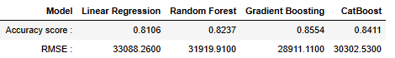
Result Interpretation
Model
Performance
Accuracy Score : Examining the updated accuracy score reveals distinct performance characteristics among the algorithms. GradientBoosting Regressor stands out with an impressive accuracy score of 0.8554, signifying its exceptional ability to explain 85.54% of the variance in the target variable. Maintaining a robust position, CatBoost Regressor yields an accuracy score of 0.8411, showcasing reliable predictive capabilities with an explanation of approximately 84.11% of the variance. Random Forest, though slightly behind with an accuracy score of 0.8237, still provides a strong explanation of around 82.37% of the variance. Linear regression has the lowest of all with an accuracy score of 0.8106. These results underscore the nuanced strengths of each algorithm, with GradientBoosting demonstrating superior accuracy.
RMSE : GradientBoosting outperforms all 4 in terms of RMSE, achieving the lowest score of 28911.1100. This suggests that GradientBoosting provides more accurate predictions.
So, the best result is obtained by Gradient Boosted Classifier.
Results
Interpretation

Slide 15
Conclusion
With the use of data analytics, many individuals can stay informed on the factors which play into market hotness such as location, population and time as explored above.
By bringing everything under one sphere of investigation, it is easier to consolidate patterns, trends and identify the factors that can give best value for their homes.
The decision of buying a home is one that should not be made lightly, and one should consider all helpful factors, to make an informed decision to buy the home at an appropriate price , with all possible living situations for their needs and wants.

Slide 16
Ethical Considerations
Legal compliance: This dataset is a fictional dataset from Kaggle and doesn’t have any legal issue.
Affordability : The housing market in itself is an incredibly unpredictable entity. The supply and the demand for houses is slowly starting to decrease, which is putting home buyers in a tricky spot for finding affordable houses. Therefore, with the excitement around buying a home needs to be ensured that the lifestyle of Americans is taken into account from an ethical standpoint. Hopefully, the information is not utilized to scam home buyers or home sellers, but it is a possibility that needs to be envisioned.

Slide 17
References
Dataset : https://www.kaggle.com/competitions/house-prices-advanced-regression-techniques/data
”How Much Is My House Worth?” - By Brai Odion-Esene, Rachel Witkowsk https://www.forbes.com/advisor/mortgages/how-much-is-my-house-worth/
“How Much Is My Home Worth?” By AJA MCCLANAHAN, https://www.investopedia.com/how-much-is-my-home-worth-5213913
“U.S. Housing Analysis: Factors Explaining Variations in Prices Independent Econometric Project” Written by Jianbin Chen, https://www.researchgate.net/publication/340418499_US_Housing_Analysis_Factors_Explaining_Variations_in_Prices_Independent_Econometric_Project

Slide 18
THANK YOU

